Slide 2

Mobile Application Development (20IT505/JO01)
By`
K. Bhaskara Rao
Asst. Prof.
Dept. of Information Technology
BEC, Bapatla
2023-24

Slide 3
Mobile Application Development
UNIT-I
Hello, Android:-Android: An Open platform for Mobile development, Android SDK Features, Introducing the Development Framework.
Getting Started:-Developing for Android, Developing for Mobile and Embedded devices.
UNIT-II
Creating Applications and Activities:-Components of an Android Application, Introducing the Application Manifest File, The Android Application Lifecycle, A Closer Look at Android Activities, Creating Activities, The Activity Lifecycle, Activity States Android Application class, Android Activities.
Building User Interfaces:- Fundamental Android UI Design, Android User Interface Fundamentals, Introducing Layouts, Introducing Fragments.

Slide 4
Mobile Application Development
UNIT-III
Intents and Broadcast Receivers:-Introducing Intents, Creating Intent Filters and Broadcast Receivers.
Saving State and User Preferences:-Creating and Saving Shared Preferences, Retrieving Shared Preferences Persisting the Application Instance State.
Creating and Using Databases:- Working with SQLite Databases.
UNIT-IV
Content Providers:- Creating Content Providers, Accessing Content Providers, using Native Android Content Providers.
Working in the Background:- Creating and Controlling Services, Binding Services to Activities.
Expanding the User Experience:- Introducing the Action Bar ,Creating and Using Menus and Action Bar Action Items.

Slide 5
Mobile application Development
Programming languages for appl. development
Procedural languages and Object Oriented
Java
Android
Platform Vendors
Mobile Platforms
Mobile Applications vs Desktop Applications
Mobile device capabilities
Mobile Application restrictions

Slide 6
Procedural vs Object Oriented Programming
Procedural Oriented Programming: Focuses on the procedures ( functions ) (rather than data) and Algorithm needed to perform the task.
Program is divided into no. of functions with each function carries a well defined task.
Dividing a problem into sub problems and solving simplifies the problem solving.
Most functions share data
Data moves openly around the functions.
Drawbacks:
No proper security for the data.
Design difficulty as the components function and data structures do not model the real world.
Ex: for UI, thinking for data structures instead of menus and menu items.
Not possible to create new data types. ( no extensibility )
Examples : C, BASIC, FORTRAN

Slide 7
Procedural vs Object Oriented Programming
Object Oriented Programming: Combines process (function) and data into a unit called an object. Hence, it focuses on objects rather than procedure.
program is composed of a collection objects that communicate with each other.
Features of Object Oriented Programming:
Its emphasis is on data rather than procedure.
It is based on the principles of inheritance, polymorphism, encapsulation and data abstraction.
It implements programs using the objects.
Data and the functions are wrapped into a single unit called class so that data is hidden and is safe from accidental alternation.
Objects communicate with each other through functions.
New data and functions can be easily added whenever necessary.
Examples: C++, JAVA, C#, VISUAL BASIC

Slide 8
JAVA
Advantages:
Simple
Platform independent
Object Oriented
Facilitating modular design
Distributed
Secure
Strong multi threading support
Strictly typed language promoting robust code development
Dis advantages:
runs slower compared to C, C++ ( because of interpreter)
Strictly Typed

Slide 9
JAVA
Using Java we can create 2 types of Applications
1. Stand Alone Application that runs normally under JVM
2. Applets ( Java executable ) that runs in a browser
Differences:
1. Applets cannot access the local file system unless digitally signing the .jar file containing it.

Slide 10
Android
Android is an open source software stack that includes the operating system, middleware, and key applications along with a set of API libraries for writing mobile applications that can shape the look, feel, and function of mobile handsets.
Android is an open source software stack produced and supported by the Open Handset Alliance (OHA) and designed to operate on any handset that meets the requirements.
OHA ( Open Handset Alliance ) is a collection of more than 30 technology companies including hardware manufacturers, mobile carriers, and software developers. ( Motorola, HTC, Qualcomm etc…)
Android applications are written using Java language.
Native Android Applications:
An email client
SMS management application
Personal information mgt. suite (contacts list, calendar, etc…)
Google maps, web browser, messaging app, music player, play store etc..

Slide 11
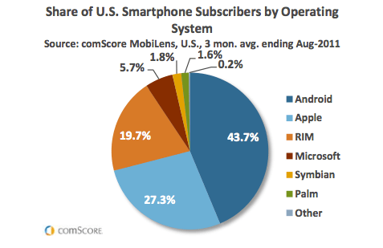
Smartphone Market Share – Aug 2021

Slide 12
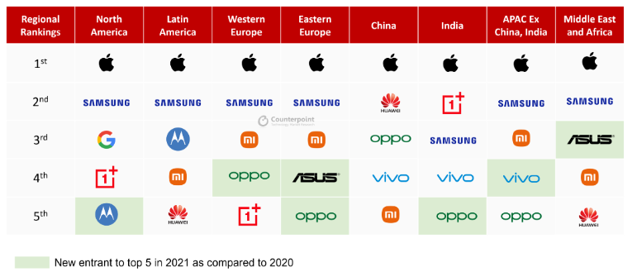
Smart phones sales % world wide

Slide 13
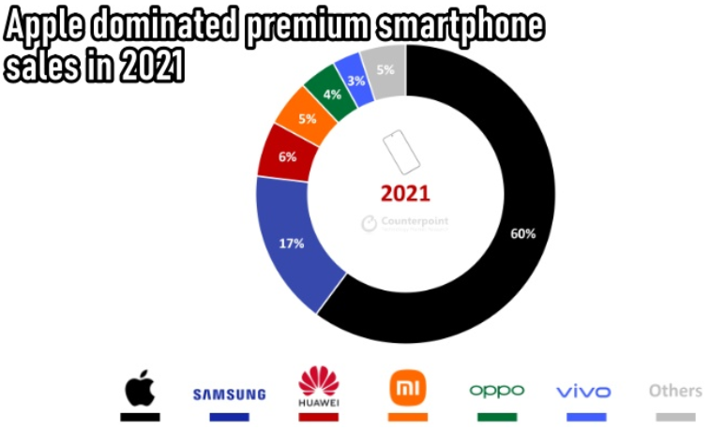
Smart phones sales % world wide

Slide 14
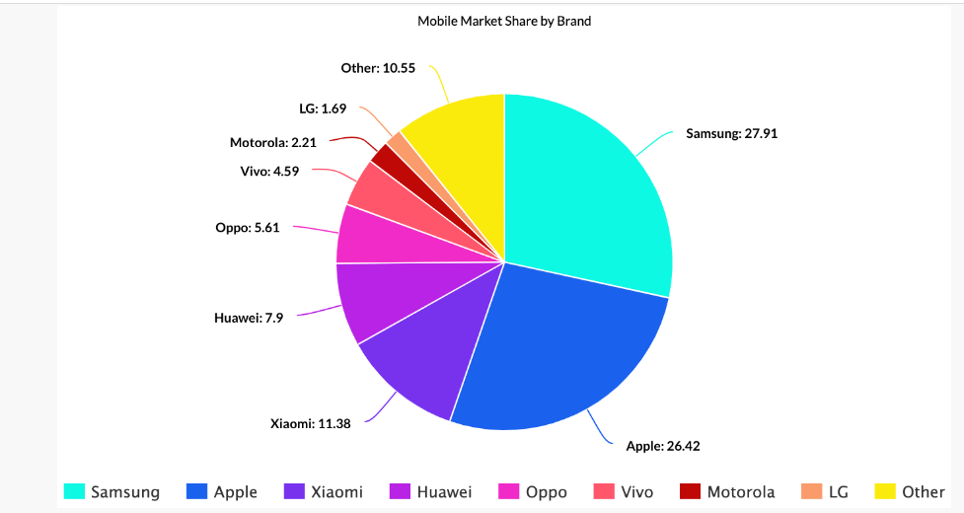
Smartphone Market Share – Aug 2021
iOS (US) – 53.00% of the market share
Android (US) – 40.54% of the market share
iOS (Global) – 26.99% of the market share
Android (Global) – 72.2% of the market share
iOS (US) – 53.00% of the market share Android (US) – 40.54% of the market share
iOS (Global) – 26.99% of the market share Android (Global) – 72.2% of the market share

Slide 15
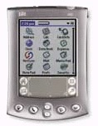

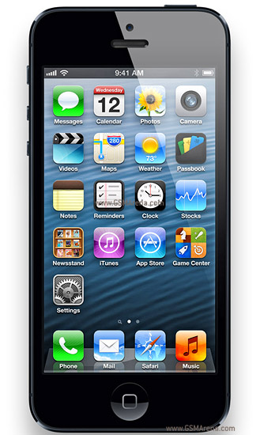
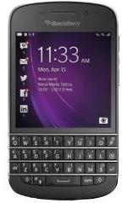
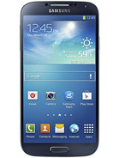
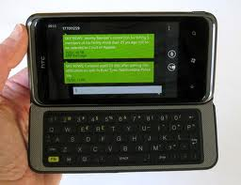
Mobiles with different OS
PDA ( Palm OS ) Nokia E60 (Symbian ) iPhone 5 ( iOS )
BlackBerry Q10 HTC 7 Pro galaxy s4 (Android)
(Windows Phone)

Slide 16
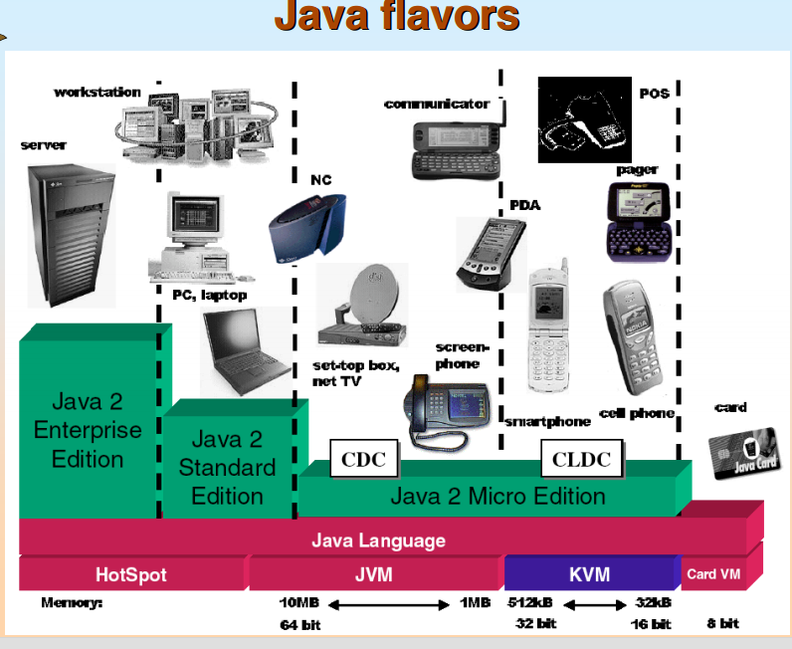
Android features contd…
Messaging : SMS, MMS, C2DM (Cloud to Device Messaging)
Multiple Language Support
Web browser: based on open source WebKit layout engine with Chrome’s V8 Java Script engine.
Java Support – Android apps are written in Java. Dalvik executables are run on Dalvik VM.
Media support: H.263, H.264, AAC, MPEG-4 etc…
mp3, MIDI, wav etc…
JPEG, PNG, GIF,BMP etc…
Streaming media support (Adobe flash streaming, Apple HTTP live streaming)
Multi – touch
Multitasking

Slide 17
Android
Android applications are written using JAVA.
Android applications run using a custom virtual machine called ‘Dalvik’ (a register based VM) rather than a traditional JVM.
Each Android application runs in a separate process within its own Dalvik instance.
Android runtime take care of memory and process management.
Android SDK includes APIs, tools for development, debugging & testing of android applications, documentation, sample code.
Dalvik VM uses the device’s underlying Linux kernel to handle low-level functionality including security, threading, and process and memory management.
Android APIs feature
hardware access,
video recording,
location-based services,
support for background services,
map-based activities,
relational databases,
inter-application communication,
Bluetooth, NFC, and 2D and 3D graphics.

Slide 18
Android benefits
Benefits:
Powerful SDK
Open Source
Excellent documentation
Over 6 lakhs premium applications built for this platform.
Integration of Google products and services into the OS. (Calendar, Google Maps, Google Drive, Gmail etc..)
Ability to run multiple applications at the same time.
Multi language support
Multimedia, Tethering support
Support of 2D, 3D graphics
Better Notification system

Slide 19
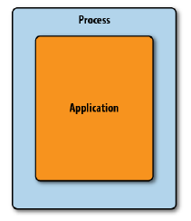
Traditional Programming Model

Slide 20
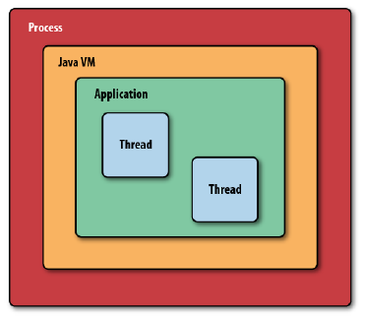
Android Programming Model

Slide 21
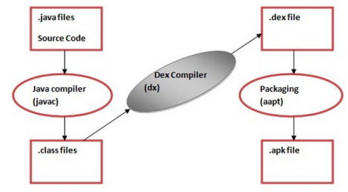
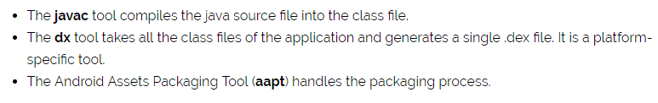
Compiling & Packaging of Java files

Slide 22
Android OS Versions
Android 1.0
Android 1.1
Android 1.5 (Cupcake)
Android 1.6 (Donut)
Android 2.0 (Éclair)
Android 2.1 (Éclair)
Android 2.2 (Froyo)
Android 2.3 (Gingerbread)
Android 3.0 (Honeycomb)
Android 4.0 (Ice-cream sandwich)
Android 4.1 (Jelly Bean)
Android 4.2 (Jelly Bean)
Android 4.3 (Jelly Bean)
Android 4.4 (KitKat)
Android 5.0 (Lollipop)
Android 5.1 (Lollipop)
Android 6.0 (MarshMallow)
Android 7.0 (Nougat)
Android 7.1 (Nougat)
Android 8.0 (Oreo)
Android 8.1 (Oreo)
Android 9.0 (Pie) - Aug. 2018
Android 10 (Quince Tart) - Sep 2019
Android 11 (Red Velvet Cake) - Sep. 2020
Android 12 (Snow Case) - Oct. 2021
Android 13 (Tiramisu) - Aug. 2022
Andriod 14 (Upside Down Cake) - Q3 2023
Android 15 (Vanilla Ice Cream) - Q3 2024

Slide 23

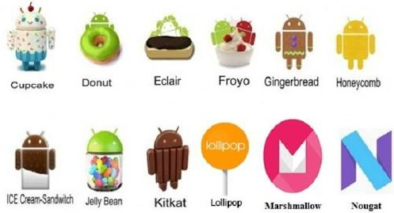
Android OS Versions
Android 1.0: Apple Pie

Slide 24
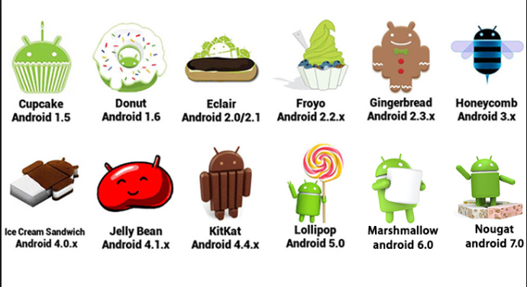
Android OS Versions

Slide 25




Android OS Versions
Android 8.0 Oreo: Android 9.0 Pie (2018)
Android 8.1 Oreo: Android 10 (2019)

Slide 26

Android OS Versions
Android 11 (Red Velvet Cake) Android 12 (Snow Case)
Android 13 (Tiramisu)

Slide 27

Android OS Versions

Slide 28
Differences between Mobile App and Desktop App
For Mobiles environment:
Same programming framework, different tools and hardware.
Network coverage is not reliable
Usage Patterns are different
Usage of Appl. in office, while moving, in sun light, noisy atmosphere.
different input and output methods.
mostly operated by one hand.
Personalization of Appl.
Small screen size ( small UI portion is visible at one time)
Different screen resolutions across devices.
Limited CPU and GPU performance.
Limited Memory.
Mobile apps can be quit and restarted at any time (ex: when call and SMS arrived).

Slide 29
Mobile Device Capabilities
OS
Wireless Networking ( Bluetooth, WiFi )
Java Capability ( Most devices support Java Micro Ed.)
Browsers
Location Capability ( GPS )
Keyboard
Local Storage
Extendible memory
Camera
Accelerometer , Light Sensor, Proximity Sensor, Gyroscope, E-compass etc…
Multi Touch Screen
Multimedia capability
SMS, MMS, Voice

Slide 30
Android OS History
Android started as a separate company in 2003. It was run by Andy Rubin
Google bought Android in 2005
In 2008, Google partnered with T-Mobile to launch the first-ever Android smartphone, the G1. ( Android OS 1.1 )
Motorola Droid phone in 2009 used Android OS 2.0.
Google launched its smartphone, the Nexus One, in January 2010.
In 2010, Samsung introduced Galaxy S smart phones (Gingerbread Android OS )
Android overtook BlackBerry in U.S. market share in the spring of 2011.
In 2011, A new Version of Android : Ice Cream Sandwich was released.
In 2012, Jelly Bean version was released.
2013 -- Kitkat
2014 – Lollipop
2015 – Marshmallow
2016 – Nougat
2017 – Oreo
2018 – Android P
-- Android Q

Slide 31
App Stores
iOS:
Apple’s App Store
Android OS:
Several stores
Android Market, Amazon Appstore for Android, GetJar
On the Web
Google Play Store
Windows Phone OS:
Windows Phone Store

Slide 32
Android devices in market
Smartphones
Tablets
E-reader devices
Netbooks ( lower weight, size, cost laptops- 1kg, 5” screen, no dvd)
MP4 players
Internet TVs
Gaming devices
GPS receivers
Home Audio
Phones
Photo frames
Printers
Ultra mobile PCs
Vehicles

Slide 33
Android
ADT plugin integrates the developer tools.
ADT plugin makes creating, testing and debugging your applications faster and easier.
ADT integrates the following into Eclipse:
Android project wizard
Resource editors, form based layout
Building of projects
Conversion of .dex to .apk
Installation of packages on to dalvik vm
Emulator
DDMS (Dalvik Debug Monitoring Service)
Access to device’s emulator’s file system.
Runtime debugging
Android console and log outputs

Slide 34
Android
The Dalvik VM executes Dalvik executable files, a format optimized to ensure minimal memory footprint.
The .dex executables are created by transforming Java language compiled classes using the tools supplied within the SDK.
Android libraries:
android.util
android.os
android.graphics
android.text
android.database
android.content
android.view
android.widget
com.google.android.maps
android.app
android.provider
android.telephony
android.webkit

Slide 35
Mobile Platforms
BlackBerry by RIM (Research In Motion ) → BlackBerry Q10, Z10, Q5
By BlackBerry Ltd. for its devices ( 8100 series, 8200 series, BlackBerry Curve etc..
Palm OS ( Garnet OS) →by Palm Inc. → for PDA
Windows Mobile → HTC 7 Pro, HTC 7 Surround, LG Optimus, Samsung Focus, LG Quantum, Nokia Lumia 820, 825, 720, 620, HTC 8S, 8X, Samsung ATIV Odyssey.
Symbian → Nokia E60, Nseries, Sony Ericsson P900, P800 Nokia 7650, Nokia N-Gage, Nokia 9500
iOS → Apple phones ( iPhone3G, 4, 4S, 5, iPod Touch, iPad Tablet, iPod Touch).
Android → Samsung galaxy, HTC dream, Motorola droid, Sony Ericsson Xperia X3, HTC dragon,
Proprietary Systems

Slide 36
Constraints and Challenges for Mobile Apps
Major Challenges:
Designing and developing multiple versions of same application to run on a wide variety of platforms.
Small screen size
Different screen sizes, resolutions and orientations
Limited input devices
Different interaction methods (keypad, stylus, touch screen)
Text input is difficult
Limited battery life and limited processing power
Limited storage
Unpredictable network connection, limited coverage, lower network bandwidth and long latency times
Varying usage environments like ambient lighting, noise, temperature
For developers it is challenging to learn different technologies, tools and APIs.
Rapid changes in technology, OS versions.

Slide 37
Mobile Appl. Dev. Tools
Symbian → for C/C++ → Nokia Carbide dev tools for Symbian OS C++, SymbDev,
for Java → Nokia Carbide dev tools for Java.
Windows Mobile → for C/C++ → Visual Studio 2005 +
and .NET →Windows Mobile SDK
Palm OS → for C/C++ →Garnet OS Dev. Suite, PRC Tools
BlackBerry → Java → BlackBerry Java Dev. Env.
Android → Eclipse ADT
All → for C/C++ → Eclipse CDT
for Java → Sun Java Wireless Toolkit

Slide 38
Android features
Features in Android :
SQLite, a lightweight relational database, is used for data storage purposes.
Connectivity
Transp, LTE, and Wi-Fi network support, enabling your app to send and retrieve data across mobile and Wi-Fi networks
Comprehensive APIs for location-based services such as GPS and network based location detection
Full support for integrating maps within the user interface
Full multimedia hardware arent access to telephony and Internet resources through GSM, EDGE, 3G, 4Gcontrol, including playback and recording with
the camera and microphone
Media libraries for playing and recording a variety of audio/video or still image formats
APIs for using sensor hardware, including accelerometers, compasses, barometers, and fingerprint sensors

Slide 39
Android features
Features in Android :
Libraries for using Wi-Fi, Bluetooth, and NFC hardware
Shared data stores and APIs for contacts, calendar, and multimedia
Background services and an advanced notification system
An integrated web browser
Video calling
Messaging
Voice based features - Google search through voice
Accessibility (Text to speech tool)
Tethering
Screen Shot
External Storage
Mobile-optimized, hardware-accelerated graphics, including a path-based
2D graphics library and support for 3D graphics using OpenGL ES 2.0
Localization through a dynamic resource framework

Slide 40
Android SDK components
The Android API Libraries
The core of the SDK is the Android API libraries that provide developer access to the Android stack. These are the same libraries that Google uses to create native Android applications.
Development tools
The SDK includes the Android Studio IDE and
several other development tools that let you compile and debug your
applications to turn Android source code into executable applications.
The Android Virtual Device Manager and Emulator
The Android Emulator is a fully interactive mobile device emulator featuring several alternative skins. The Emulator runs within an Android Virtual Device (AVD) that simulates a device hardware configuration.
Full documentation
The SDK includes extensive code-level reference information detailing exactly what’s included in each package and class and how to use them.

Slide 41
Android SDK components
Sample code—The Android SDK includes a selection of sample applications that demonstrate some of the possibilities available with Android, as well as simple programs that highlight how to use individual API features.
Online support—Android has vibrant developer communities on most online social networks, Slack, and many developer forums. Stack Overflow www.stackoverflow.com /questions/tagged/android) is a hugely popular destination for Android questions and a great place to find answers to beginner questions

Slide 42
Popular development environments
Java ME
Windows Mobile (.NET Compact Framework (C++, C#, VB.NET))
Windows Phone 7 (Silverlight and XNA)
Qualcomm’s BREW (C or C++)
Symbian (C++)
BlackBerry (Java)
Android (Java)
iPhone (Objective-C)

Slide 43
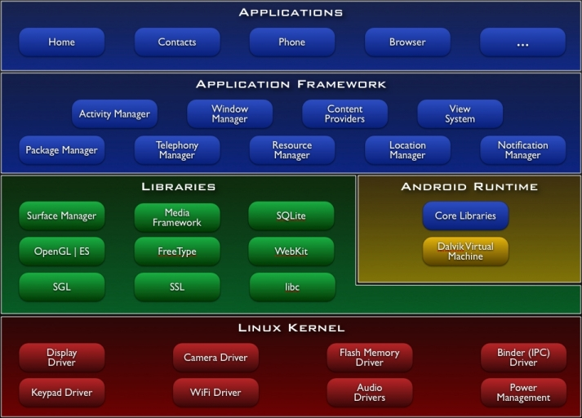
Android Architecture

Slide 44
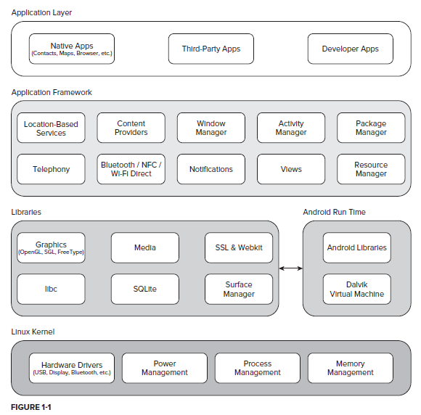
Android Software Stack

Slide 45
Android architecture
Linux kernel functionalities:
Hardware abstraction
Process management
Memory management
Power management
Device drivers
Support for Shared Libraries
Network stack

Slide 46
Android architecture
Linux Kernel
Libraries, Android Runtime
Application Framework
Applications
Linux Kernel: This is the Lowest layer which contains low level device drivers for the various hardware components of Android device.
Libraries: Contains all the code that provides main features of the Android OS.
Surface Manager - manages access to display subsystem and composes 2D and 3D graphics layers from multiple applications.
Media Framework - Supports playbacks and recording of various audio, video and picture formats. (provides media codecs ).
SQLite - a powerful and lightweight relational database engine for persistent data storage.

Slide 47
Android architecture
Libraries (c/c++) : These contain all the code that provides main features of an Android OS.
SSL : - A cryptographic protocol for providing secure communication over the internet. ( ex: internet banking)
WebKit : Browser engine for displaying html content.
libc : System C libraries
SGL (Scalable Graphics Library): 2D graphics library (in android.graphics.drawable package) for handling 2D rendering.
OpenGL/ES : 3D library (in android.opengl package)
freetype : font rendering

Slide 48
Android architecture
Dalvik Virtual Machine :
It is a Register based Virtual Machine.
It is optimized for low memory requirements.
It has been designed to allow multiple VM instances to run at once.
Is a Custom VM designed for mobiles.
Performs process mgt., memory mgt., threading and security.
Dalvik VM executes Dalvik executables (.dex extension)
Core Libraries: Core libraries are provided that enable developers to write Android apps using the Java language.
Application Framework Layer :
Our applications directly interact with these blocks of the Android architecture.
Provides classes used to create android applications.
These programs manage the basic functions of phone like resource management, voice call management etc.

Slide 49
Android
c/c++ libraries:
openGL
FreeType
SGL
libc
SQLite
SSL
Advanced Android libraries:
android.location
android.media
android.opengl
android.hardware
android.bluetooth
android.net.wifi

Slide 50
Android architecture
Application Framework:
Activity Manager: Manages the activity life cycle of applications. To understand the Activity component in Android
Content Providers: Manage the data sharing between applications.
Telephony Manager: Manages all voice calls. We use telephony manager if we want to access voice calls in our application.
Location Manager: Location management, using GPS or cell tower
Resource Manager: Manage the various types of resources we use in our Application.
Window Manager: Manages Windows. Decides which windows are visible, how they are laid on the screen, opening, closing windows, screen rotations etc..
Application Layer : Standard applications that come with OS are available in this layer.
Ex : SMS Client App
Web browser
Dialer, music, gallary,
Calendar, Calculator etc…

Slide 51
Android
Activity is the base class for the visual, interactive components of your application; it is roughly equivalent to a Form in traditional desktop development.
Public class HelloWorld extends Activity{
public void onCreate(Bundle icicle) {
super.onCreate(icicle);
setContentView(R.layout.main);
}
}
Visual components are called views. They are similar to controls in windows apps.
The resources for an Android project are stored in the res folder of your project hierarchy, which includes drawable, layout, and values subfolders

Slide 52
Android
activity_main.xml file:
<RelativeLayout >
<TextView
android:id=”@+id/myTextView”
android:layout_width="wrap_content"
android:layout_height="wrap_content"
android:text="@string/hello_world" />
</RelativeLayout>
Accessing control in code: (MyActivity.java):
Add id attribute to them in the xml file (activity_main.xml)
Use the findViewById( ) method to return a reference to the control.
TextView myTextView = (TextView)findViewById(R.id.myTextView);

Slide 53
Structure of an Android Application
src folder : Contains the java source files for your project
Contains MainActivity.java, the source file for your appl.
Android 4.2.2 library : contains android.jar, which contains all the class libraries needed for your appl.
gen folder: contains R.java → a compiler-generated file which references all the resources found in your project.
assets : contains all the assets ( html, text files, databases)
Used by your project.
res: folder which contains all the resources used in your prj. Contains drawable, values, layout folders.
AndroidManifest.xml : specifies permissions for your appl. And other features such as intent-filters and receivers.

Slide 54
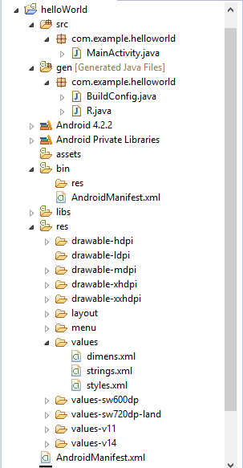
Android Application Structure

Slide 55
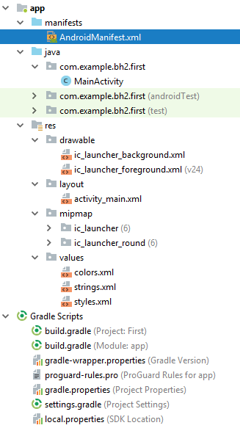
Android Studio Project Structure

Slide 56
Android Studio Project Structure
AndroidManifest.xml → It contains information of the package, including components of the application such as activities, services, broadcast receivers, content providers etc.
It is responsible to protect the application to access any protected parts by providing the permissions
It also declares the android api that the application is going to use
It lists the instrumentation classes. The instrumentation classes provides profiling and other informations. These information are removed just before the application is published etc.
java folder → The java folder contains the Java source code files of the application.

Slide 57
Android Studio Project Structure
res folder → Res folder is where all the external resources for the application such as images, layout XML files, strings, animations, audio files etc. are stored.
sub folders:
drawable: This folder contains the bitmap files to be used in the program. There are different folders to store drawables. They are drawable-ldpi, drawable-mdpi, drawable-hdpi, drawable-xdpi etc.
The folders are to provide alternative image resources to specific screen configurations. Ldpi, mdpi & hdpi stands for low density, medium density & high density screens respectively.
layout: It contains XML files that define the User Interface of the application.
menu: XML files that define menus for the application goes into this folder.
mipmap: The mipmap folders is used for placing the app icons only. Any other drawable assets should be placed in the relevant drawable folders.
values: XML files that define simple values such as strings, arrays, integers, dimensions, colors, styles etc. are placed in this folder.

Slide 58
Android Studio Project Structure
R.java: A Class R is auto generated in R.java.
Not visible from inside Android Studio is a generated Java class named R, which can be found in the app/build/generated/source/r/debug/<pkgname>/ directory of the project. R contains nested classes that in turn contain all the resource IDs for all your resources.
Every time you add, change or delete a resource, R is re-generated. For instance, if you add an image file named logo.png to the res/drawable directory, Android Studio will generate a field named logo under the drawable class, a nested class in R.
The purpose of having R is so that you can refer to a resource in your code. For instance, you can refer to the logo.png image file with R.drawable.logo.

Slide 59
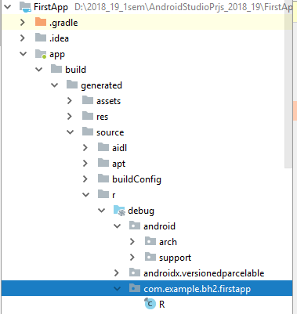
R.java

Slide 60
Android Studio Project Structure
Gradle Scripts: Gradle scripts are used to automate tasks. For the most part, Android Studio performs application builds in the background without any intervention from the developer. This build process is handled using the Gradle system, an automated build toolkit.

Slide 61
Hardware imposed design considerations
Compared to laptops mobiles have relatively:
Low processing power
Limited RAM
Limited permanent storage capacity
Small screens with low resolution
Higher costs associated with data transfer
Slower data transfer rates with higher latency
Less reliable data connections
Limited battery life

Slide 62
Practical design considerations
Performance → Be fast and efficient.
At a time when 2 to 4GB of memory is standard for most desktop and server rigs, typical smart phones feature approximately 200MB of SDRAM. With memory such a scarce commodity, you need to take special care to use it efficiently.
Responsiveness → Android takes responsiveness seriously. It Activity Manager or Window Manager detects an unresponsive application, it will display “not responding” message.
using worker threads and services to perform lengthy tasks.
Android monitors two conditions to determine responsiveness:
An application must respond to any user action, such as keypress or screen touch, within 5 seconds.
A broadcast receiver must return from onReceive handler within 10 seconds.

Slide 63
Practical design considerations
Freshness → While designing application it is critical that you consider that how often you will update the data it uses, minimizing the time users are waiting for refreshes or updates, while limiting the effect of these background updates on the battery life.
Security → Access to network and hardware causes security problems. Device security is most important one.
The Android security model sandboxes each application and restricts
access to services and functionality by requiring applications to declare the permissions they require. During installation users are shown the application’s required permissions before they commit to installing it.
Seamlessness → A consistent user experience in which applications start, stop and transition instantly without perceptible delays.

Slide 64
Building blocks of Android application
Activities → Your application’s presentation layer
Services → Invisible workers of your application
Content Providers → A shared data store
Intents → To send broadcast messages to an activity or service.
Broadcast Receivers → Intent broadcast consumers
Notifications → Notifications let you signal users without stealing
focus or interrupting their current Activities.
Widgets → Visual application components that are typically added to the device HOME screen.

Slide 65
Building Blocks of Android Application
Activity is a window that contains the UI of your application.
It is analogue to the window or dialog in a desktop appl.
An application can have 0 or more activities
Content Provider :
Provides a level of abstraction for any data stored on the device that is accessible by multiple applications.
Intents : Intents are system messages notifying applications of various events ( SMS arrived, SD card removed, activity launched)
Intent can be used to launch other activities.
Services : activities, intents and content providers are short lived. Services runs longer independent of activities .
Broadcast Receivers: Intent listeners. Broadcast Receivers enable your application to listen for Intents that match the criteria you specify.
Widgets: Visual application components that are typically added to the device home screen. Widgets enable you to create dynamic, interactive
application components for users to embed on their home screens.

Slide 66
Types of Android Applications
Foreground Applications → Having user interaction.
Ex: games
Background Applications → An application with limited interaction. Mostly run in the background.
Ex: Alarm Clock
Intermittent Applications → Email & Media Players, chat applications.
These applications are generally union of visible activities, invisible background services and broadcast receivers.
Widgets and Live Wallpapers → Is a small control of the application placed on the home screen.
Allows you to put favourite applications on home screen in order to quickly access them.
Widget only applications are commonly used to display dynamic information, such as battery levels, weather forecasts, or the date and time.

Slide 67
Exploring Android Studio IDE
Android Development Tools

Slide 68
Exploring Android Studio IDE
The Android Studio IDE contains the following features:
It has a flexible Gradle-based build system.
It has a fast and feature-rich emulator for app testing.
Android Studio has a consolidated environment where we can develop for all Android devices.
Apply changes to the resource code of our running app without restarting the app.
Android Studio provides extensive testing tools and frameworks.
It supports C++ and NDK.(Native Dev Kit)
It provides build-in supports for Google Cloud Platform. It makes it easy to integrate Google Cloud Messaging and App Engine.
The Toolbar → The toolbar lets you carry out a wide range of actions, including running your app and launching Android tools.
Navigation Bar →The navigation bar helps you navigate through your project and open files for editing.
Editor Window → The editor window is where you create and modify code.
Tool windows → Tool windows give you access to specific tasks like project management, search, version control, and more.
Status Bar → The status bar displays the status of your project and the IDE itself, as well as any warnings or messages.
You can organize the main window to give yourself more screen space by hiding or moving toolbars and tool windows.
You can also use keyboard shortcuts to access most IDE features.

Slide 69
Exploring Android Studio IDE
Search: At any time, you can search across your source code, databases, actions, elements of the user interface, and so on, by double-pressing the Shift key, or clicking the magnifying glass in the upper right-hand corner of the Android Studio window.
Tool Windows: By default, the most commonly used tool windows are pinned to the tool window bar at the edges of the application window.
You can also drag, pin, unpin, attach, and detach tool windows.
Code completion: You can also perform quick fixes and show intention actions by pressing Alt+Enter.
1. Basic Complection: Ctrl + Space → Displays basic suggestions for variables, types, methods, expressions, and so on.
2. Smart Completion: Ctrl + Shift + Space →Displays relevant options based on the context.
3. Statement Completion: Ctrl + Shift + Enter → Completes the current statement for you, adding missing parentheses, brackets, braces, formatting, etc.

Slide 70
Exploring Android Studio IDE
Tool Windows:
Android Studio also includes a number of other windows which, when enabled, are displayed along the bottom and sides of the main window.
The tool window quick access menu can be accessed by hovering the mouse pointer over the button located in the far left hand corner of the status bar without clicking the mouse button.
Layout Editor:
We can build the layout quickly by adding different attributes either by hard-code or drag and drop using the layout editor feature of the android studio. The layout editor feature can also be used, to preview the codes that can be seen easily on the visual editor screen and changes can be made accordingly by resizing it dynamically.

Slide 71
Exploring Android Studio IDE
Templates
Android also has the feature of templates built-in. If you know to build that accordingly that makes your task easier. Templates can be used to create common Android designs and components.
Support KOTLIN
KOTLIN can be considered the official language for Android. It runs fast and equivalent to Java. Kotlin can be easily learned and used by java developers as it based on automated Java only.
Enabling Integration with Firebase
You can get real-time experience with IoT based project development with dynamic upgrades in the application using the firebase feature of an android studio. Chat applications can be created by using firebase connectivity it helps you to give a happy chat experience.
Emulator
The emulator feature of the android studio provides an emulator that is exactly like the android phones to test how the application looks like in physical devices. It gives real-time experience to Android applications. It allows you to test your applications faster and on different-different configuration devices like tablets, android phones, etc. Basically it helps to run and debug apps in the Android studio.

Slide 72
Exploring Android Studio IDE
Colour Previews
Android studio helps to see the code XML part in a preview to know that how perfectly we are designing the application according to the need before launching the application. It provides powerful functionality and enhanced features of drag and drops or resizes the application. It contains drag and drop features but not support for every function, that’s why be careful while doing that.
Maven Repository
In Android Studio, Maven integration of its repository can be done, within SDK manager support libraries of IDE is used. It’s a kind of a repository which is a directory in which various jar files like project jars, Plugin are stored.

Slide 73
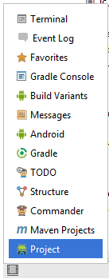
Exploring Android Studio IDE

Slide 74
Exploring Android Studio IDE
Some Mostly used Windows:
Project – The project view provides an overview of the file structure that makes up the project allowing for quick navigation between files. Generally, double clicking on a file in the project view will cause that file to be loaded into the appropriate editing tool.
Structure – The structure tool provides a high level view of the structure of the source file currently displayed in the editor. This information includes a list of items such as classes, methods and variables in the file. Selecting an item from the structure list will take you to that location in the source file in the editor window.
Favorites – A variety of project items can be added to the favorites list. Right clicking on a file in the project view, for example, provides access to an Add to Favorites menu option. Similarly, a method in a source file can be added as a favorite by right clicking on it in the Structure tool window. Anything added to a Favorites list can be accessed through this Favorites tool window.
Build Variants – The build variants tool window provides a quick way to configure different build targets for the current application project (for example different builds for debugging and release versions of the application, or multiple builds to target different device categories).

Slide 75
Exploring Android Studio IDE
TODO – As the name suggests, this tool provides a place to review items that have yet to be completed on the project. Android Studio compiles this list by scanning the source files that make up the project to look for comments that match specified TODO patterns. These patterns can be reviewed and changed by selecting the File -> Settings… menu option and navigating to the TODO page listed under IDE Settings.
Messages – The messages tool window records output from the Gradle build system (Gradle is the underlying system used by Android Studio for building the various parts of projects into a runnable applications) and can be useful for identifying the causes of build problems when compiling application projects.
Android – The Android tool window provides access to the Android debugging system. Within this window tasks such as monitoring log output from a running application, taking screenshots and videos of the application, stopping a process and performing basic debugging tasks can be performed.
Terminal – Provides access to a terminal window on the system on which Android Studio is running. On Windows systems this is the Command Prompt interface, whilst on Linux and Mac OS X systems this takes the form of a Terminal prompt.

Slide 76
Exploring Android Studio IDE
Run – The run tool window becomes available when an application is currently running and provides a view of the results of the run together with options to stop or restart a running process. If an application is failing to install and run on a device or emulator, this window will typically provide diagnostic information relating to the problem.
Event Log – The event log window displays messages relating to events and activities performed within Android Studio. The successful build of a project, for example, or the fact that an application is now running will be reported within this window tool.
Gradle Console – The Gradle console is used to display all output from the Gradle system as projects are built from within Android Studio. This will include information about the success or otherwise of the build process together with details of any errors or warnings.
Maven Projects – Maven is a project management and build system designed to ease the development of complex Java based projects and overlaps in many areas with the functionality provided by Gradle. Google has chosen Gradle as the underlying build system for Android development, so unless you are already familiar with Maven or have existing Maven projects to import, your time will be better spent learning and adopting Gradle for your projects. The Maven projects tool window can be used to add, manage and import Maven based projects within Android Studio.
Addition of New Activity as a Code Template

Slide 77
Exploring Android Studio IDE
Gradle – The Gradle tool window provides a view onto the Gradle tasks that make up the project build configuration. The window lists the tasks that are involved in compiling the various elements of the project into an executable application. Right-click on a top level Gradle task and select the Open Gradle Config menu option to load the Gradle build file for the current project into the editor. Gradle will be covered in greater detail later in this book.
Commander – The Commander window tool can best be described as a combination of the Project and Structure tool windows, allowing the file hierarchy of the project to be traversed and for the various elements that make up classes to be inspected and loaded into the editor or designer windows.
Memory Monitor – Connects to running Android applications and monitors memory usage statistics in the form of a real-time graph.
Designer – Available when the UI Designer is active, this tool window provides access to the designer’s Component Tree and Properties panels.

Slide 78
Android Studio ID E features
Addition of New Activity as a Code Template
Yes, Android also has the feature of templates built-in. If you know to build that accordingly that makes your task easier. it has both pros and cons, you don’t find every template in Android Studio. It’s an additional feature which helps the developer to build an application efficiently and effectively which provide effective solutions.
Help to Build Up App for All Devices
Android studio builds applications for every screen size, for wear and gear devices etc. It also can stimulate the various type of features which a hardware has like GPS location tracker, multi-touch.

Slide 79
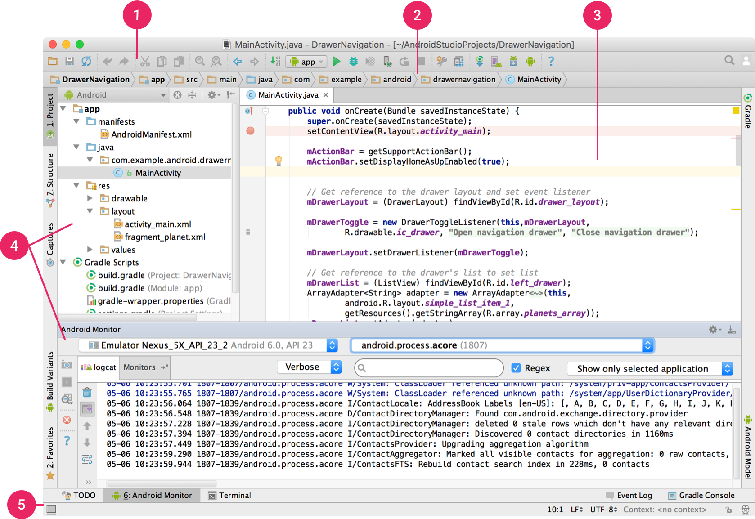
Exploring Android Studio IDE

Slide 80
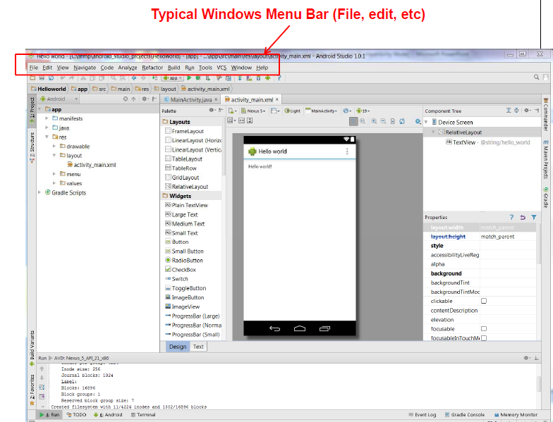

Slide 81
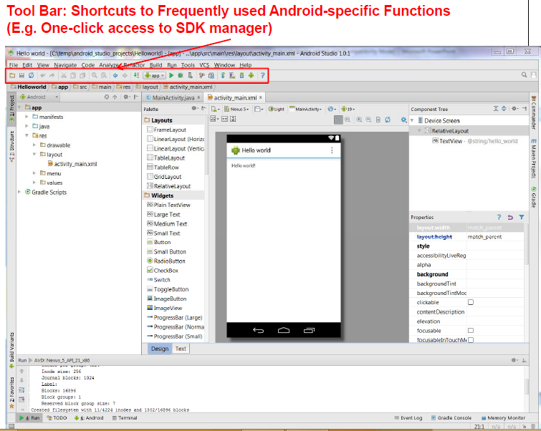

Slide 82
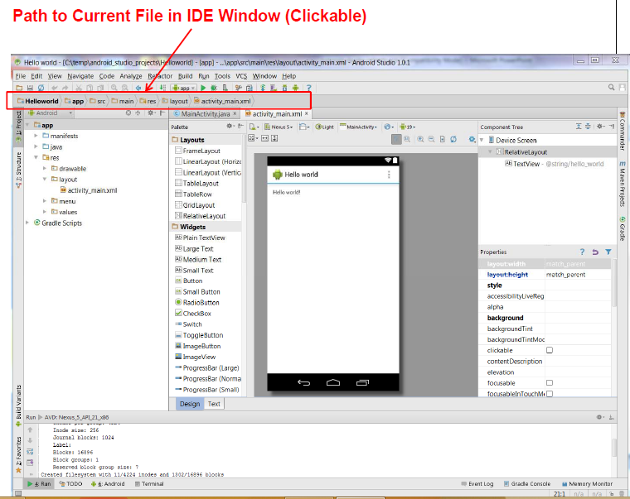

Slide 83
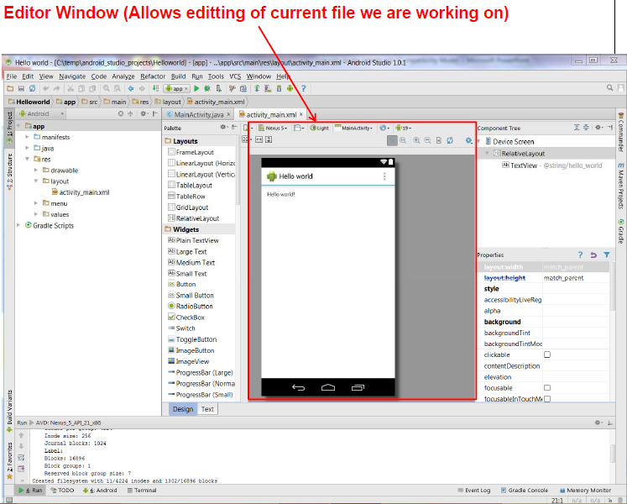

Slide 84
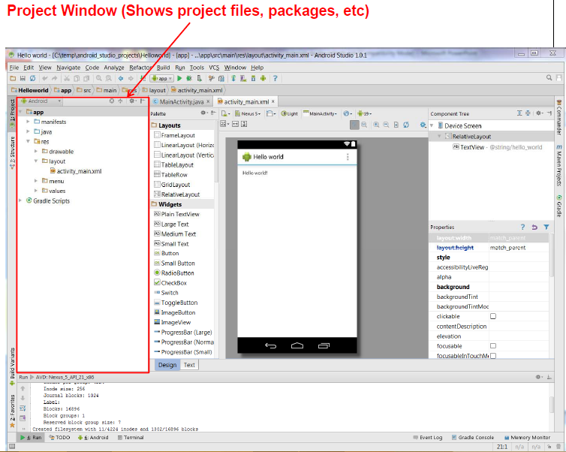

Slide 85
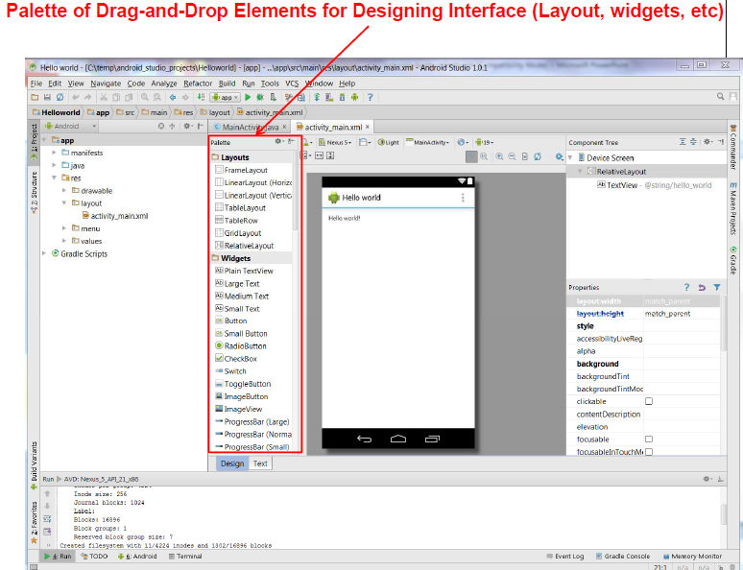

Slide 86
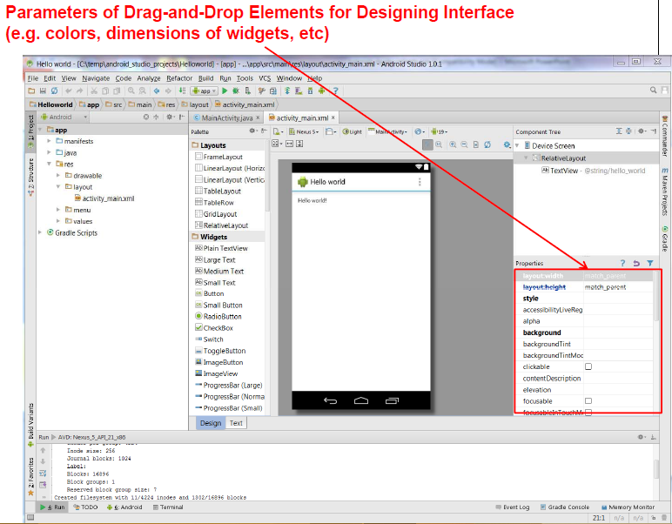

Slide 87
ADT (Andriod Development Tools)

Slide 88
Android Development Tools
Android Studio incorporates all of these tools:
The Android Virtual Device Manager and Emulator—The AVD
Manager is used to create and manage AVDs, virtual hardware that hosts an
Emulator running a particular build of Android. Each AVD can specify a
particular screen size and resolution, memory and storage capacities, and
available hardware capabilities (such as touch screens and GPS). The
Android Emulator is an implementation of the Android Run Time designed
to run within an AVD on your host development computer.
The Android SDK Manager—Used to download SDK packages including
Android platform SDKs, support libraries, and the Google Play Services SDK.
Android Profiler—Visualize the behavior and performance of your app.
The Android Profiler can track memory and CPU use in real time, as well
as analyze network traffic.
Lint—A static analysis tool that analyzes your application and its resources to suggest improvements and optimizations.

Slide 89
Android Development Tools
Gradle—An advanced build system and toolkit that manages the compilation, packaging, and deployment of your applications.
Vector Asset Studio—Generates bitmap files for each screen density to
support older versions of Android that don’t support the Android vector drawable format.
APK Analyzer—Provides insight into the composition of your built APK
files.

Slide 90
Android Development Tools
The following additional tools are also available:
Android Debug Bridge (ADB)—A client-server application that provides a link between your host computer and virtual and physical Android devices. It lets you copy files, install compiled application packages (.apk), and run shell commands.
Logcat—A utility used to view and filter the output of the Android logging system.
Android Asset Packaging Tool (AAPT)—Constructs the distributable Android package files (.apk).
SQLite3—A database tool that you can use to access the SQLite database files created and used by Android.
Hprof-conv—A tool that converts HPROF profiling output files into a standard format to view in your preferred profiling tool.
Dx—Converts Java .class bytecode into Android .dex bytecode.
Draw9patch—A handy utility to simplify the creation of NinePatch graphics using a WYSIWYG editor.
Monkey and Monkey Runner—Monkey runs within the Android Run Time, generating pseudorandom user and system events. Monkey Runner provides an API for writing programs to control the VM from outside your application.
ProGuard—A tool to shrink and obfuscate your code by replacing class, variable, and method names with semantically meaningless alternatives.
This is useful to make your code more difficult to reverse engineer.

Slide 91
Creating Resources
AndroidManifest.xml file
Some Basic Controls examples

Slide 92
AndroidManifest.xml file
The manifest file presents essential information about your app to the Android system, information the system must have before it can run any of the app's code.
The manifest lets you define the structure and metadata (icon, version number and theme) of your application and its components.
It does the following:
It names the Java package
It describes the components of application ( content providers, activities, services, broadcast receivers
It determines which processes will host application components.
It declares which permissions the application must have in order to access protected parts of the API and interact with other applications.
It also declares the permissions that others are required to have in order to interact with the application's components.
It lists the Instrumentation classes that provide profiling and other information.
It declares the minimum level of the Android API that the application requires
It lists the libraries that the application must be linked against.

Slide 93
AndroidManifest.xml file
Version code is an integer value that represents the version of the code. It is used internally by Android OS to check for updates. It is incremented by 1 for every release.
Version name is the string / value of version displayed for end user only.
(Major.Minor.Point) form.
uses-configuration node: specify each combination of
input mechanisms are supported by your application.
<uses-configuration android:reqTouchScreen=”finger”
android:reqNavigation=”trackball”
android:reqHardKeyboard=”true”
android:reqKeyboardType=”qwerty”/>

Slide 94
AndroidManifest.xml file
uses-feature node: uses-feature nodes to specify which hardware features your application requires.
<uses-feature android:name=”android.hardware.nfc” />
optional features: Audio, Bluetooth, Camera, Location, Microphone, NFC, Sensors, Telephony, TouchScreen, USB, Wi-Fi.
uses-library node: Used to specify a shared library that this application requires, for ex: the maps API.
<uses-library android:name=”com.google.android.maps”
android:required=”false”/>

Slide 95
<?xml version="1.0" encoding="utf-8"?>
<manifest xmlns:android="http://schemas.android.com/apk/res/android"
package="com.example.helloworld2"
android:versionCode="1"
android:versionName="1.0" >
<uses-sdk android:minSdkVersion="8“ android:targetSdkVersion="17" />
<application
android:allowBackup="true"
android:icon="@drawable/ic_launcher"
android:label="@string/app_name"
android:theme="@style/AppTheme" >
<activity
android:name="com.example.helloworld2.MainActivity"
android:label="@string/app_name" >
<intent-filter>
<action android:name="android.intent.action.MAIN" />
<category android:name="android.intent.category.LAUNCHER" />
</intent-filter> </activity> </application> </manifest>

Slide 96
Creating Resources
Using Resources
Activity Life Cycle
Basic Views, Picker Views, List Views
Android Layouts

Slide 97
Creating Resources
It’s always good practice to keep non-code resources, such as images and string constants, external to your code.
Android supports the externalization of resources such as strings, colors, images, animations, themes and menus.
It supports internationalization and different screen size and resolution, languages.
Android automatically selects correct resources based on the screen size, language etc..

Slide 98
Resource Types
anim folder: XML files that define View animations (like changing size, position, rotation & transparency). They are saved in res/anim/ folder and accessed from the R.anim class.
Animator → The animator resource directory can contain XML files that define property animations ( change the property of Views: ex – translateX, TextScaleX) for View objects in your app.
Color → (colors.xml) XML files that define a state list of colors. They are saved in res/color/ and accessed from the R.color class.
Drawable → The drawable folder holds all the images for your project. Android currently supports BMP, GIF, JPG, PNG, and WebP image formats. (drawable animation can be applied on the images of this folder).
Referring drawables:
“@drawable/filename”
Font → The font folder holds any custom font files you wish to use. Android currently supports ttf, otf, ttc, and xml font files.
Referring Fonts in xml file:
“@font/filename”

Slide 99
Resource Types
Layout → The layout folder holds all the XML layout files for your projects.
Menu → XML files that define application menus, such as an Options Menu, Context Menu, or Sub Menu. They are saved in res/menu/ and accessed from the R.menu class.
Transition
Values → this folder contains strings.xml, colors.xml, styles.xml etc..
colors.xml → The colors file holds the hex codes for each color your would like to use in your app.
defining color values:
<color name=”app_background”>#FF0000FF</color>
usage:
for a view: android:background="@color/colorPrimary"
dimens.xml → The dimen file holds all the “measurements” for your layouts. You can create new dimensions by adding a new dimen element, giving it a name, and adding your desired dimension in sp for text and dp for everything else.
ex: <dimen name="dim1">10px</dimen>
usage: in xml file, you can refer as: “@dimen/dimenname”
XML → This directory houses arbitrary XML files used by Android for various tasks, such as defining search configurations or external capabilities, such as the use of Android Auto.
mipmap →The mipmap folder holds the icon image for your apps launcher.
raw → The raw folder holds media files such as video and audio.
referring raw resource in java code: R.raw.rawfilename

Slide 100
values folder
XML files that contain simple values, such as strings, integers, and colors.
arrays.xml for resource arrays, and accessed from the R.array class.
integers.xml for resource integers, and accessed from the R.integer class.
bools.xml for resource boolean, and accessed from the R.bool class.
colors.xml for color values, and accessed from the R.colorclass.
dimens.xml for dimension values, and accessed from the R.dimen class.
strings.xml for string values, and accessed from the R.string class.
styles.xml for styles, and accessed from the R.style class.
plurals.xml → Similar to strings, plurals allows you to provide alternative strings when a number is passed into the retrieval function. This handles situations where a string quantifier should change based on the number of items it represents.

Slide 101
Simple Values
Supported simple values include strings, colors, dimensions, styles, and string or integer arrays.
All simple values are stored within XML files in the res/values folder.
Strings: <string name="hello_world">Hello world!</string>
Dimensions: <dimen name="dim1">10px</dimen>
integer-array:
<integer-array name="evennos">
<item >10</item>
<item >20</item>
<item >30</item>
<item >40</item>
</integer-array>

Slide 102
Simple Values
string-array:
Ex: <string-array name="names">
<item >Bapatla</item>
<item >Guntur</item>
<item >Chirala</item>
</string-array>

Slide 103
Simple Values example
<?xml version=”1.0” encoding=”utf-8”?>
<resources>
<string name=”app_name”>To Do List</string>
<plurals name=”androidPlural”>
<item quantity=”one”>One android</item>
<item quantity=”other”>%d androids</item>
</plurals>
<color name=”app_background”>#FF0000FF</color>
<dimen name=”default_border”>5px</dimen>
<string-array name=“string_array“>
<item>Item 1</item>
<item>Item 2</item>
<item>Item 3</item>
</string-array>
<array name=“integer_array“>
<item>3</item>
<item>2</item>
<item>1</item>
</array>
</resources>

Slide 104
Strings
In strings.xml file : (res/values/strings.xml file)
<resources>
<string name="app_name">StylesThemesEx</string>
<string name="hello_world">Hello world!</string>
<string name="Theme1str">Theme1 Text</string>
</resources>
In activity_main.xml file (res/layout/activity_main.xml file)
<TextView
android:id="@+id/textView1"
style="@style/SpecialText"
android:layout_width="wrap_content"
android:layout_height="wrap_content"
android:text="@string/hello_world" />

Slide 105
Styles & Themes
A style is a set of one or more formatting attributes that you can apply as a unit to single elements in your layout XML file(s).
ex: certain text size and color
A theme is a set of one or more formatting attributes that you can apply as a unit to all activities in an application or just a single activity.
ex: colors for the window frame and the panel foreground and background, text sizes and colors for menus.

Slide 106
Defining and using styles
In styles.xml file : (res/values/styles.xml file )
<resources> <style name="SpecialText" parent="@style/Text">
<item name="android:textSize">18sp</item>
<item name="android:textColor">#008</item> </style> </resources>
In activity_main.xml file :
<TextView
android:id="@+id/textView1"
style="@style/SpecialText"
android:layout_width="wrap_content"
android:layout_height="wrap_content"
android:text="@string/hello_world" />

Slide 107
<Button
android:id="@+id/button2"
android:layout_width="wrap_content"
android:layout_height=“fill_parent"
android:layout_x="12dp"
android:layout_y="100dp"
android:text="@string/btn2str" />
wrap_content: width of the button will be same as that of its content.
fill_parent: height of the button occupies the entire height of the parent (screen).

Slide 108
<TextView
android:id="@+id/tv_test"
android:layout_width="wrap_content"
android:layout_height="wrap_content"
android:background="@color/colorPrimary"
android:text="@string/title"
style="@style/TitleStyle"/>
using Resources in java code:
getResources().getColor(R.color.colorPrimary);
getResources().getDrawable(R.drawable.kittens);
getDimension(),getFont(), getIntArray(), getInteger(),
getString(), getStringArray(), getValue(), getXml()

Slide 109
Defining and using themes
Defining theme is done in styles.xml file as a style.
A theme is applicable to an activity whole or all the activities of an App.
In styles.xml file :
<resources>
<style name="CustomTheme">
<item name="android:windowNoTitle">true</item>
<item name="menuItemTextColor">?panelTextColor</item> <item name="menuItemTextSize">?panelTextSize</item> </style>
</resources>
In AndroidManifest.xml file :
<application android:theme="@style/CustomTheme">

Slide 110
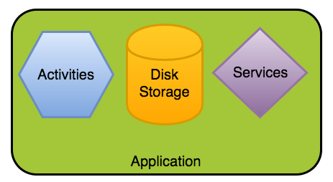
Android Application Class
The Application class in Android is the base class within an Android app that contains all other components such as activities and services.
The Application class, or any subclass of the Application class, is instantiated before any other class when the process for your application/package is created.
This class is primarily used for initialization of global state before the first Activity is displayed.
Note that custom Application objects should be used carefully and are often not needed at all.

Slide 111
Android Application Class
Base class for maintaining global application state.
You can provide your own implementation by creating a subclass and specifying the fully-qualified name of this subclass as the "android:name" attribute in your AndroidManifest.xml's <application> tag.
The Application class, or your subclass of the Application class, is instantiated before any other class when the process for your application/package is created.

Slide 112
Application Class methods
Method | Description
static String getProcessName() | Returns the name of the current process.
void onConfigurationChanged(Configuration newConfig) | Called by the system when the device configuration changes while your component is running.
void onCreate() | Called when the application is starting, before any activity, service, or receiver objects (excluding content providers) have been created.
void onLowMemory() | This is called when the overall system is running low on memory, and actively running processes should trim their memory usage.
void onTerminate() | This method is for use in emulated process environments.
void onTrimMemory(int level) | Called when the operating system has determined that it is a good time for a process to trim unneeded memory from its process.

Slide 113
Custom Application Class
In many apps, there's no need to work with an application class directly. However, there are a few acceptable uses of a custom application class:
Specialized tasks that need to run before the creation of your first activity
Global initialization that needs to be shared across all components (crash reporting, persistence)
Static methods for easy access to static immutable data such as a shared network client object
Note that you should never store mutable shared data inside the Application object since that data might disappear or become invalid at any time. Instead, store any mutable shared data using persistence strategies such as files, SharedPreferences or SQLite.
However, you should never store mutable instance data inside the Application object because if you assume that your data will stay there, your application will inevitably crash at some point with a NullPointerException.
the app won’t be restarted from scratch. Android will create a new Application object and start the activity where the user was before to give the illusion that the application was never killed in the first place.
If we do want a custom application class, we start by creating a new class which extends android.app.Application as follows:

Slide 114
Android Application Class
public class MyCustomAppl extends Application{
@override
public void onCreate(){ }
@override
public void onConfigurationChanged(){ }
@override
public void onLowMemory(){ }
}
In the AndroidManifest.xml:
<application android:name=".MyCustomAppl"
android:icon="@drawable/icon"
android:label="@string/app_name" ...>

Slide 115
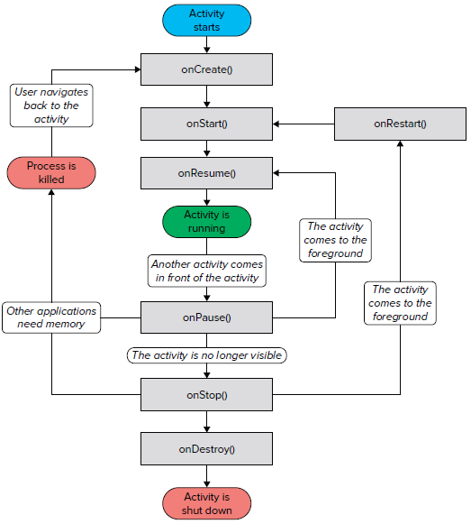
Activity Life Cycle

Slide 116
Activity Life Cycle
States of an activity :
Resumed: In this state, activity is in the foreground and the user can interact with it. Also called “running” state.
Paused: In this state, the activity is partially obscured by another activity. The other activity does not cover full screen.
The paused activity does not receive user input and cannot execute any code.
Stopped: In this state, the activity is completely hidden and not visible to the user. Activity information and all of its state ( variables ) is retained, but it cannot execute any code.

Slide 117
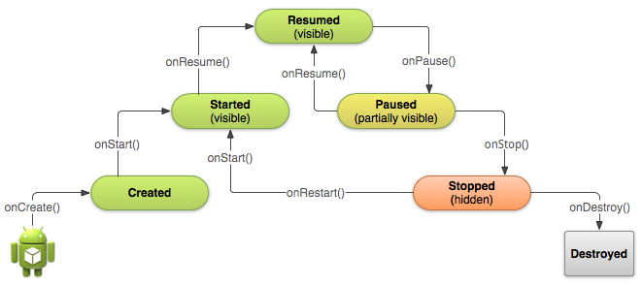
Activity Life Cycle

Slide 118
Android Activity State transitions
Case 1: When the activity is first loaded:
onCreate( ) → onStart( ) → onResume( )
Case 2: When the back button is pressed:
onPause( ) → onStop( ) → onDestroy( )
Case 3: When the HOME button is pressed:
onPause( ) → onStop( )
Case 2: When the application is started again:
onRestart( ) → onStart( ) → onResume( )

Slide 119
Life cycle methods
Use the onCreate( ) method to create and instantiate the objects that you will be using in your application.
Use the onResume( ) method to start any services or code that needs to run while your activity is in the foreground.
Use the onPause( ) method to stop any services or code that does not need to run when your activity is not in the foreground.
Use the onDestroy( ) method to free up resources before your activity is destroyed.

Slide 120
Android Application Class

Slide 121
scenerios
When HOME buton is pressed :
onPause( )
onSaveInstanceState( )
onStop( )
When BACK button is pressed:
onPause( )
onStop( )
onDestroy( )

Slide 122
Method call sequence in orientation change
Press Ctrl F12 after entering text in EditText controls.
Sequence of method calls:
onPause( )
onSaveInstanceState( )
onStop( )
onDestroy( )
onCreate( )
onRestoreInstanceState( )
onResume( )

Slide 123
Basic Views, Picker Views, List Views
Android Layouts

Slide 124
Views & View Groups
View:
An activity contains views and view groups.
A view is a widget that has an appearance on screen.
Examples of views are buttons, labels, and text boxes. A view derives from the base class android.view.View.
ViewGroup:
One or more views can be grouped together into a ViewGroup. A ViewGroup (which is itself a special type of view) provides the layout in which you can order the appearance and sequence of views.
Examples of ViewGroups include LinearLayout and FrameLayout.
A ViewGroup derives from the base class android.view.ViewGroup.

Slide 125
Picker Views
DatePicker → for selecting date.
TimePicker → for selecting time.
TimePicker:
Methods:
setIs24HourView(Boolean is24HourView): Sets whether this widget displays time in 24-hour mode or 12-hour mode with an AM/PM picker.
int setMinute(int minute) : Sets the currently selected minute
int setHour(int hour): Sets the currently selected hour using 24-hour time.
int getHour(): Returns the currently selected hour using 24-hour time.
int getMinute() : Returns the currently selected minute.

Slide 126
Basic views
TextView
EditText
Button
ImageButton
CheckBox
ToggleButton
RadioButton
RadioGroup
ProgressBar
AutoCompleteTextView

Slide 127

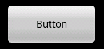

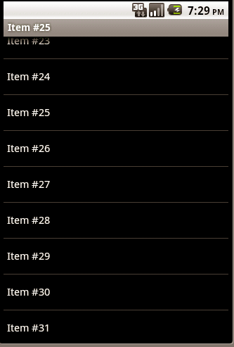

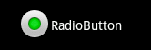

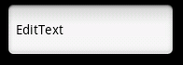
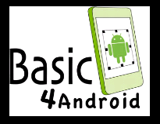

Basic UI Controls
Button: Label : ProgressBar ListView (ListBox)
Checkbox: RadioButton
EditText (TextBox): ScrollView
Image View: Panel

Slide 128

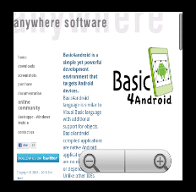
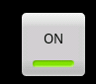
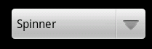
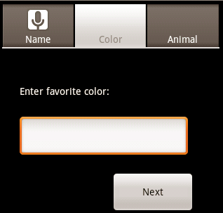
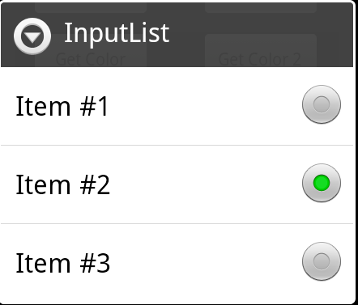
Basic UI Controls
SeekBar (TrackBar) ToggleButton WebView
Spinner (ComboBox)
TabHost (TabControl) InputList

Slide 129
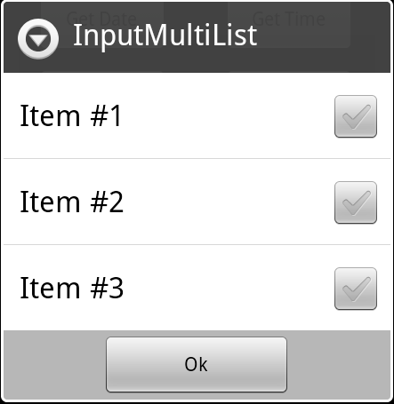
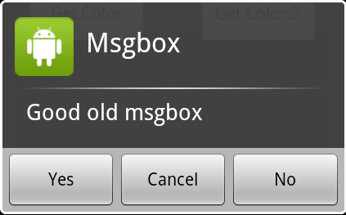
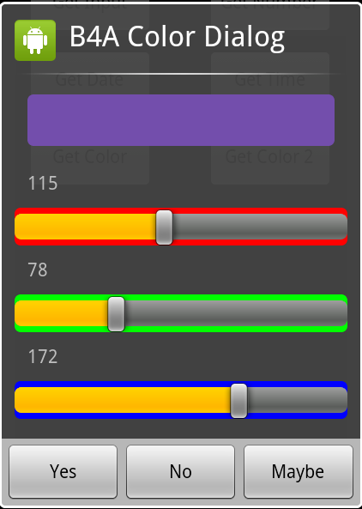
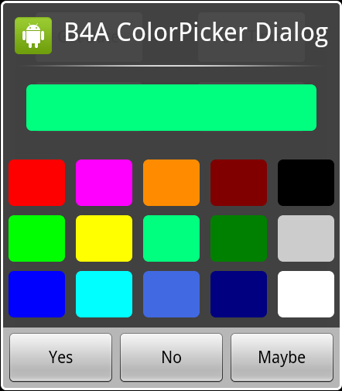
Basic views
InputMultiList MsgBox
ColorDialog ColorPickerDialog

Slide 130
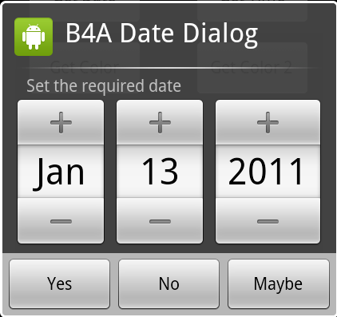
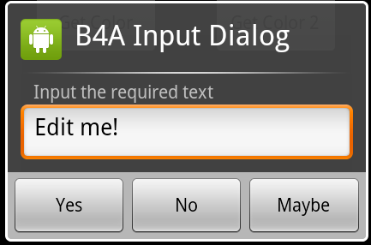
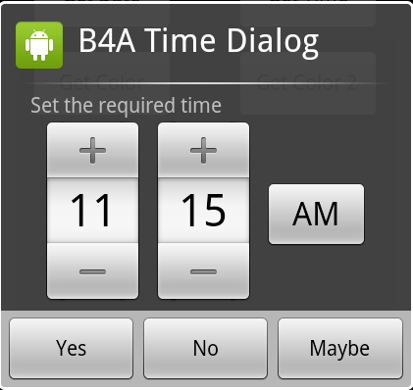

Basic views
DateDialog InputDialog
TimeDialog NumberDialog

Slide 131

Basic views
FileDialog

Slide 132
Attributes in the Views and ViewGroups
layout_width → Specifies the width of the View or ViewGroup
layout_height → Specifies the height of the View or ViewGroup
Layout_marginTop → Specifies extra space on the top side of the View or ViewGroup
Layout_marginBottom
layout_marginLeft
layout_marginRight
layout_x → Specifies the x-coordinate of the View or ViewGroup
layout_y → Specifies the y-coordinate of the View or ViewGroup
layout_gravity → attribute indicates the positions the views should gravitate towards.
layout_weight → attribute specifies the distribution of available space

Slide 133

layout_gravity & layout_weight
<Button
android:layout_width=”160dp”
android:layout_height=”wrap_content”
android:text=”Button”
android:layout_gravity=”left”
android:layout_weight=”1” />
<Button
android:layout_width=”160dp”
android:layout_height=”wrap_content”
android:text=”Button”
android:layout_gravity=”center”
android:layout_weight=”2” />
<Button
android:layout_width=”160dp”
android:layout_height=”wrap_content”
android:text=”Button”
android:layout_gravity=”right”
android:layout_weight=”3” />

Slide 134
Button event handling
1. get the control by using its id.
Button btnOpen = (Button) findViewById(R.id.btnOpen);
2. Register Listener to the control and add handler implementation.
btnOpen.setOnClickListener(new View.OnClickListener() {
public void onClick(View v) {
Toast.makeText(getBaseContext(), “clicked on Open button”,Toast.LENGTH_SHORT).show();
}
});

Slide 135
Layouts
LinearLayout: Aligns a sequence of child Views in either a vertical or a horizontal line.
RelativeLayout: Define the position of each element within the layout in terms of its parent and the other Views.
GridLayout: The Grid Layout uses an arbitrary grid to position Views. By using row and column spanning, the Space View, and Gravity attributes, you can create complex without resorting to the often complex nesting required to construct UIs using the Relative Layout.
FrameLayout: The FrameLayout is a placeholder on screen that you can use to display a single view. Views that you add to the FrameLayout are always anchored to the top left of the layout.
TableLayout: Groups Views into rows and columns. Use <TableRow> to designate a row in the table.
ScrollView: ScrollView is a special type of FrameLayout in that it enables users to scroll through a list of views that occupy more space than the physical display.

Slide 136
LinearLayout
The LinearLayout arranges views in a single column or a single row. Child views can be arranged either vertically or horizontally.
<LinearLayout
xmlns:android=”http://schemas.android.com/apk/res/android”
android:orientation=”vertical”
android:layout_width=”fill_parent”
android:layout_height=”fill_parent”
>
<TextView
android:layout_width=”fill_parent”
android:layout_height=”wrap_content”
android:text=”@string/hello”
/>
</LinearLayout>

Slide 137
AbsoluteLayout
The AbsoluteLayout enables you to specify the exact location of its children
<AbsoluteLayout xmlns:android="http://schemas.android.com/apk/res/android"
xmlns:tools="http://schemas.android.com/tools"
android:layout_width="match_parent"
android:layout_height="match_parent"
android:paddingBottom="@dimen/activity_vertical_margin"
android:paddingLeft="@dimen/activity_horizontal_margin"
android:paddingRight="@dimen/activity_horizontal_margin"
android:paddingTop="@dimen/activity_vertical_margin"
tools:context=".MainActivity" >
<Button
android:id="@+id/button1"
android:layout_width="wrap_content"
android:layout_height="wrap_content"
android:layout_marginLeft="17dp"
android:layout_marginTop="20dp"
android:layout_x="126dp"
android:layout_y="10dp"
android:text="@string/btn1str" />
</AbsoluteLayout>

Slide 138
TableLayout
The TableLayout groups views into rows and columns. You use the <TableRow> element to designate a row in the table. Each row can contain one or more views. Each view you place within a row forms a cell.

Slide 139
RelativeLayout
The RelativeLayout enables you to specify how child views are positioned relative to each other.
Attributes for Views:
Attribute | Description
android:layout_above | Positions the bottom edge of this view above the given anchor view ID.
android:layout_alignBottom | Makes the bottom edge of this view match the bottom edge of the given anchor view ID.
android:layout_alignEnd | Makes the end edge of this view match the end edge of the given anchor view ID.
android:layout_alignLeft | Makes the left edge of this view match the left edge of the given anchor view ID.
android:layout_alignParentBottom | If true, makes the bottom edge of this view match the bottom edge of the parent.
android:layout_alignParentEnd | If true, makes the end edge of this view match the end edge of the parent.
android:layout_alignParentLeft | If true, makes the left edge of this view match the left edge of the parent.

Slide 140
Attributes for Views in relative layout
Attribute | Description
android:layout_alignParentRight | If true, makes the right edge of this view match the right edge of the parent.
android:layout_alignParentStart | If true, makes the start edge of this view match the start edge of the parent.
android:layout_alignParentTop | If true, makes the top edge of this view match the top edge of the parent.
android:layout_alignRight | Makes the right edge of this view match the right edge of the given anchor view ID.
android:layout_alignStart | Makes the start edge of this view match the start edge of the given anchor view ID.
android:layout_alignTop | Makes the top edge of this view match the top edge of the given anchor view ID.

Slide 141
Attributes for Views in relative layout
Attribute | Description
android:layout_centerVertical | If true, centers this child vertically within its parent.
android:layout_below | Positions the top edge of this view below the given anchor view ID.
android:layout_centerHorizontal | If true, centers this child horizontally within its parent.
android:layout_centerInParent | If true, centers this child horizontally and vertically within its parent.

Slide 142
FrameLayout
The FrameLayout is a placeholder on screen that you can use to display a single view. Views that you add to a FrameLayout are always anchored to the top left of the layout.

Slide 143
ScrollView

Slide 144
PickerView, ListViews, AutoCompleteTextView
Menus, ProgressBar, SeekBar, CalendarView

Slide 145
ProgressBar
The ProgressBar view provides visual feedback about some ongoing tasks, such as when you are performing a task in the background.
Ex: downloading files/movies.

Slide 146
AutoCompleteTextView
The AutoCompleteTextView is a view that is similar to EditText (in fact it is a subclass of EditText), except that it shows a list of completion suggestions automatically while the user is typing.

Slide 147
Menus
Options menu - Displays information related to the current activity. In Android, you activate the options menu by pressing the MENU key.
Context menu - Displays information related to a particular view on an activity. In Android, to activate a context menu you tap and hold on to it.

Slide 148
OptionsMenu
Options menu - Displays information related to the current activity. In Android, you activate the options menu by pressing the MENU key.
You Need to override two methods i) onCreateOptionsMenu( ) and onOptionsItemSelected( ) methods.
onCreateOptionsMenu( ) is called when you pressed MENU button.
In this method, call helper method to display options menu.
When a menu item is selected, onOptionsItemSelected( ) method is called.
MenuItem class:
add( ) method: add(int groupId, int itemId, int order, String title)
groupId → group id of the menuitem
itemId → unique item ID
Order → the order in which the item should be displayed
Title → the text to display for the menu item
Menu mnu;
Ex: MenuItem mnu1=mnu.add(0,0,0,”item 1”);
mnu.setAlphabeticshortcut(‘a’);
mnu.setIcon(R.drawable.icon);
getItemId( ) method of MenuItem is used to determine the MenuItem selected.

Slide 149
ContextMenu
A context menu is usually associated with a view on an activity, and it is displayed when the user taps and holds an item.
For example, if the user taps on a Button view and holds it for a few seconds, a context menu can be displayed.
If you want to associate a context menu with a view on an activity, you need to call the setOnCreateContextMenuListener() method of that particular view.7
When the user taps and holds the Button view, the
onCreateContextMenu() method is called.
when an item inside the context menu is selected, the
onContextItemSelected() method is called.

Slide 150
Context Menu
Displays information related to a particular view on an activity.
To activate a context menu you tap and hold on to it for a few seconds.
To associate a context menu with a view, call setOnCreateContextMenuListener( ) method of that particular view.
Ex: btn.setOnCreateContextMenuListener(this);
onCreateContextMenu( ) is called whenever you tap and hold a view for a few seconds.
In this method call CreateMenu( ) method to create a context menu.
An item selection from context menu calls onContextItemSelected( ) method.

Slide 151
Application Class

Slide 152
ViewGroups
Listviews
Adapting to Display orientation,
Managing Changes to Screen Orientation
using Adapters.

Slide 153
ViewGroups
A ViewGroup is a invisible container for one or more views.
A Layout is also a ViewGroup
Examples for ViewGroups are: RadioGroup, ScrollView and all Layouts.
A ViewGroup derives from android.view.ViewGroup

Slide 154

ViewGroups

Slide 155
Adapting to Display Orientation
Android supports two orientations: 1. Portrait
2. Landscape
When you change the orientation of the device, your current activity is actually destroyed and then re-created.
Two techniques for handling display orientations:
Anchoring → fixing the views to the four edges of the screen. When the screen orientation changes, the views can anchor to the edges neatly.
Resizing & Repositioning → Resizing and Repositioning each and every view according to the current screen orientation. This is the effective technique.

Slide 156
Controlling orientation of Activity
setting the screen orientation to landscape:
1) In onCreate() method:
//---change to landscape mode---
setRequestedOrientation(ActivityInfo.SCREEN_ORIENTATION_LANDSCAPE);
Or
in AndroidManifest.xml file:
<activity
android:screenOrientation="landscape“>
</activity>

Slide 157
Detecting orientation changes
in onCreate() method:
@Override
protected void onCreate(Bundle savedInstanceState) {
super.onCreate(savedInstanceState);
setContentView(R.layout.activity_main);
if(getResources().getConfiguration().orientation == Configuration
.ORIENTATION_LANDSCAPE) {
Log.d("StateInfo", "Landscape");
}else if(getResources().getConfiguration().orientation == Configuration
.ORIENTATION_PORTRAIT){
Log.d("StateInfo", "Portrait");
}
}

Slide 158
ListView
List views are views that enable you to display a long list of items.
Two types of List Views → ListView & SpinnerView
Spinner view displays a single item from the list at a time.
List view displays more items at a time.

Slide 159
Spinner

Slide 160
Spinner
In Android, Spinner provides a quick way to select one value from a set of values.
Android spinners are nothing but the drop down-list seen in other programming languages. In a default state, a spinner shows its currently selected value.
It provides a easy way to select a value from a list of values.
In Simple Words we can say that a spinner is like a combo box of AWT or swing where we can select a particular item from a list of items.
Spinner is associated with Adapter view so to fill the data in spinner we need to use one of the Adapter class
To fill the data in a spinner we need to implement an adapter class.
A spinner is mainly used to display only text field so we can implement Array Adapter for that.
We can also use Base Adapter and other custom adapters to display a spinner with more customize list. Suppose if we need to display a textview and a imageview in spinner item list then array adapter is not enough for that.
Whenever any item from the spinner is selected, onItemSelected( ) method is executed.

Slide 161
Spinner
ArraryAdapter:
An adapter is a bridge between UI component and data source that helps us to fill data in UI component.
It holds the data and send the data to adapter view then view can takes the data from the adapter view and shows the data on different views like as list view, grid view, spinner.
Whenever you have a list of single items which is backed by an array, you can use Array Adapter.

Slide 162
DatePicker
int getMonth( )
int getDayOfMonth( )
int getYear( )
boolean isEnabled( )
void setEnabled(boolean enabled)
void setFirstDayOfWeek(int day) → sets the first day of week

Slide 163

ListViews – ListView, Spinner
AutoCompleteTextView
PickerViews – TimePicker, DatePicker
Seekbar
ProgressBar
GridView
Toolbar
Externalizing Resources
Application Components
RecyclerView
VideoView
ViewPager

Slide 164
Displaying Pictures and Menus
ImageView
Gallery
GridView
ImageSwitcher
The Gallery view together with an ImageView to display a series of thumbnail images so that when one is selected, the selected image is displayed in the ImageView.
ImageSwitcher when used with Gallery view provides some animation to the image ( fade-in, fade-out)

Slide 165

Adapter

Slide 166

Adapter

Slide 167
Adapters
BaseAdapter →It is parent adapter for all other adapters
SimpleAdapter → In Android SimpleAdapter is an easy Adapter to map static data to views defined in an XML
file(layout).
ListAdapter
ArrayAdapter → It is used whenever we have a list of single items which is backed by an array
CursorAdapter
SpinnerAdapter
ImageAdapter
Custom Array Adapter → It is used whenever we need to display a custom list
Simple Adapter → It is an easy adapter to map static data to views defined in your XML file
Custom Simple Adapter → It is used whenever we need to display a customized list and needed
to access the child items of the list or grid
You create the ImageAdapter class (which extends the BaseAdapter class) so that it can bind to the Gallery view with a series of ImageView views.
The BaseAdapter class acts as a bridge between an AdapterView and the data source that feeds data into it.
Adapter Views:
ListView
GridView
Spinner
Gallery

Slide 168
SimpleAdapter
In Android SimpleAdapter is an easy Adapter to map static data to views defined in an XML file(layout).
You also specify an XML file that defines the views used to display the row, and a mapping from keys in the Map to specific views.
Constructor:
public SimpleAdapter (Context context, List<? extends Map<String, ?>> data, int resource, String[] from, int[] to)
Where: Context: The context where the View associated with this SimpleAdapter is running
List: A List of Maps. Each entry in the List corresponds to one row in the list. The Maps contain the data for each row, and should include all the entries specified in "from“.
resource: Resource identifier (id) of a view layout that defines the views for this list item. The layout file should include at least those named views defined in "to“ .
from: A list of column names (strings) that will be added to the Map associated with each item.
to: The views that should display column in the "from" parameter. These should all be TextViews. The first N views in this list are given the values of the first N columns in the from parameter.

Slide 169
SpinnerAdapter
Extended Adapter that is the bridge between a Spinner and its data. A spinner adapter allows to define two different views: one that shows the data in the spinner itself and one that shows the data in the drop down list when the spinner is pressed.

Slide 170
GridView

Slide 171
GridView
The GridView shows items in a two-dimensional scrolling grid. You can use the GridView together with an ImageView to display a series of images.

Slide 172
ToolBar

Slide 173
ProgressBar

Slide 174
ProgressBar
In Android, ProgressBar is used to display the status of work being done like analyzing status of work or downloading a file etc.
In Android, by default a progress bar will be displayed as a spinning wheel but If we want it to be displayed as a horizontal bar then we need to use style attribute as horizontal.
It mainly use the “android.widget.ProgressBar” class.
To add a progress bar to a layout (xml) file, you can use the <ProgressBar> element. By default, a progress bar is a spinning wheel (an indeterminate indicator).
To change to a horizontal progress bar, apply the progress bar’s horizontal style.
Important Methods Used In ProgressBar:
1. getMax() – returns the maximum value of progress bar
We can get the maximum value of the progress bar in java class. This method returns a integer value. Below is the code to get the maximum value from a Progress bar.
// initiate the progress bar
ProgressBar simpleProgressBar=(ProgressBar) findViewById(R.id.simpleProgressBar);
int maxValue=simpleProgressBar.getMax(); // get maximum value of the progress bar

Slide 175
ProgressBar
2. getProgress() – returns current progress value
We can get the current progress value from a progress bar in java class. This method also returns a integer value. Below is the code to get current progress value from a Progress bar.
ProgressBar simpleProgressBar=(ProgressBar)findViewById(R.id.simpleProgressBar); // initiate the progress bar int progressValue=simpleProgressBar.getProgress(); // get progress value from the progress bar.
Attributes of ProgressBar In Android:
1. id: id is an attribute used to uniquely identify a Progress bar.
2. max: max is an attribute used in android to define maximum value of the progress can take. It must be an integer value like 100, 200 etc.
3. progress: progress is an attribute used in android to define the default progress value between 0 and max. It must be an integer value.
4. progressDrawable: progress drawable is an attribute used in Android to set the custom drawable for the progress mode.
5. background: background attribute is used to set the background of a Progress bar. We can set a color or a drawable in the background of a Progress bar.
6. indeterminate: indeterminate attribute is used in Android to enable the indeterminate mode. In this mode a progress bar shows a cyclic animation without an indication of progress. This mode is used in application when we don’t know the amount of work to be done. In this mode the actual working will not be shown.

Slide 176
Fragments

Slide 177
Fragments
Android Fragment is the part of activity, it is also known as sub-activity.
It represents a portion of UI that the user sees on the screen.
A Fragment is a combination of an XML layout file and a java class much like an Activity.
Fragments are standalone components that can contain views, events and logic.
There can be more than one fragment in an activity.
Fragments represent multiple screen inside one activity.
Android Fragments cannot exist outside an activity.
Each fragment has its own life cycle methods that is affected by activity life cycle because fragments are embedded in activity.
Fragments encapsulate views and logic so that it is easier to reuse within activities.
The FragmentManager class is responsible to make interaction between fragment objects.
Another name for Fragment can be Sub-Activity as they are part of Activities.
Fragments can be dynamically added and removed as per the requirements.
Fragments improve the adaptability & user experience by making the UI flexible for all devices.

Slide 178
Uses of Fragments
Uses:
Reusing View and Logic Components - Fragments enable re-use of parts of your screen including views and event logic over and over in different ways across many disparate activities. For example, using the same list across different data sources within an app.
Tablet Support - Often within apps, the tablet version of an activity has a substantially different layout from the phone version which is different from the TV version. Fragments enable device-specific activities to reuse shared elements while also having differences.
Screen Orientation - Often within apps, the portrait version of an activity has a substantially different layout from the landscape version. Fragments enable both orientations to reuse shared elements while also having differences.

Slide 179

Fragments

Slide 180



Fragments

Slide 181

Fragment Lifecycle

Slide 182
Fragment Lifecycle methods
SL. NO. | METHOD | DESCRIPTION
1) | onAttach(Activity) | it is called only once when it is attached with activity.
2) | onCreate(Bundle) | It is used to initialize the fragment.
3) | onCreateView(LayoutInflater, ViewGroup, Bundle) | creates and returns view hierarchy.
4) | onActivityCreated(Bundle) | It is invoked after the completion of onCreate() method.
5) | onViewStateRestored(Bundle) | It provides information to the fragment that all the saved state of fragment view hierarchy has been restored.
6) | onStart() | makes the fragment visible.
7) | onResume() | makes the fragment interactive.
8) | onPause() | is called when fragment is no longer interactive.
9) | onStop() | is called when fragment is no longer visible.
10) | onDestroyView() | allows the fragment to clean up resources.
11) | onDestroy() | allows the fragment to do final clean up of fragment state.
12) | onDetach() | It is called immediately prior to the fragment no longer being associated with its activity.

Slide 183
Fragment Types
Fragment Types:
1. Single Fragments
Single fragments show only a single view for the user on the screen. These are for handheld devices such as mobile phones.
2. List Fragments
List fragments are those that have a special list view feature. In this, there’s a list and the user can choose to see a Sub-Activity.
3. Fragment Transactions
Fragment transactions are for the transition from one fragment to another. It supports switching between two fragments.

Slide 184
Fragments
Embedding a Fragment in an Activity:
There are two ways to add a fragment to an activity:
dynamically using Java and
statically using XML.
Method 1:
import androidx.appcompat.app.AppCompatActivity;
public class MainActivity extends AppCompatActivity { // ... }
Any activity using fragments should make sure to extend from FragmentActivity or AppCompatActivity:
Method 2: o add the fragment statically, simply embed the fragment in the activity's xml layout file:
<?xml version="1.0" encoding="utf-8"?>
<LinearLayout xmlns:android="http://schemas.android.com/apk/res/android"
android:layout_width="match_parent"
android:layout_height="match_parent"
android:orientation="vertical" >
<fragment
android:name="com.example.android.FooFragment"
android:id="@+id/fooFragment"
android:layout_width="match_parent"
android:layout_height="match_parent" />
</LinearLayout>

Slide 185
ListFragment
A list fragment is a fragment that contains a ListView, displaying a list of items from a data source such as an array or a Cursor.
A list fragment is very useful, as you may often have one fragment
that contains a list of items (such as a list of RSS postings), and another fragment that displays details about the selected posting.
To create a list fragment, you need to extend the ListFragment
base class.

Slide 186
ListFragment
A list fragment is a fragment that contains a ListView, displaying a list of items from a data source such as an array or a Cursor.
In the class extended from Fragment,
public static class ExampleFragment extends Fragment { @Override public View onCreateView(LayoutInflater inflater, ViewGroup container,Bundle savedInstanceState) { // Inflate the layout for this fragment return inflater.inflate(R.layout.example_fragment, container, false); } }
Id → The resource ID of the layout you want to inflate.
Container → parent of the inflated layout.
Boolean value (3rd param) → Indicates whether the inflated layout should be attached to the ViewGroup (the second parameter) during inflation.

Slide 187
DialogFragment
A dialog fragment floats on top of an activity and is displayed modally.
Dialog fragments are useful for cases in which you need to obtain the user’s response before continuing with execution.
To create a dialog fragment, you need to extend the DialogFragment base class.
Call getFragmentManager() of Activity class to Return the FragmentManager for interacting with fragments associated with this fragment's activity.
abstract FragmentTransaction beginTransaction() Start a series of edit operations on the Fragments associated with this FragmentManager.

Slide 188
PreferenceFragment
Your Android applications will typically provide preferences that allow users to personalize the application for their own use.
For example, you may allow users to save the login credentials that they use to access their web resources, or save information such as how often the feeds must be refreshed (such as in an RSS reader application), and so on.
In Android, you can use the PreferenceActivity base class to display an activity for the user to edit the preferences

Slide 189
PreferenceFragment
Handling of user preferences (editing, and storing) can be handled by using a hierarchy of preferences via XML.
Easy and powerful way of handling user preferences.
PreferenceFragment contains a hierarchy of preference objects as lists. These preferences will automatically save to SharedPreferences as the user interacts with them.
To retrieve an instance of SharedPreferences that the preference hierarchy in this fragment will use, call PreferenceManager.getDefaultSharedPreferences(android.content.Context) with a context in the same package as this fragment.

Slide 190
WebView
Gallery view
ImageSwitcher
Fragments – ListFragment, DialogFragment & PreferenceFragment
Dialogs

Slide 191
WebView
WebView is a view that display web pages inside your application.
You can also specify HTML string and can show it inside your application using WebView. WebView makes turns your application to a web application.
In order to load a web url into the WebView, you need to call a method loadUrl(String url) of the WebView class, specifying the required url.
Ex: WebView browser = (WebView) findViewById(R.id.webview);
browser.loadUrl("http://www.google.com");
WebView class methods:
getUrl() → return the url of the current page.
getTitle() → This method return the title of the current page.
destroy() → This method destroy the internal state of WebView.
clearHistory() → This method will clear the WebView forward and backward history.
canGoForward() → This method specifies the WebView has a forward history item.
canGoBack() → This method specifies the WebView has a back history item.
getProgress() → This method gets the progress of the current page.

Slide 192
Gallery view
The Gallery is a view that shows items (such as images) in a center-locked, horizontal scrolling list.

Slide 193
ImageAdapter
public class ImageAdapter extends BaseAdapter {
public ImageAdapter(Context c) { ... }
//---returns the number of images---
public int getCount() { ... }
//---returns the item---
public Object getItem(int position) { ... }
//---returns the ID of an item---
public long getItemId(int position) { ... }
//---returns an ImageView view---
public View getView(int position, View convertView, ViewGroup parent) { ... }
}

Slide 194
ImageAdapter
getView() method returns a View at the specified position.
This method creates a new View for each image added to the ImageAdapter. When this is called, a View is passed in, which is normally a recycled object (at least after this has been called once), so there's a check to see if the object is null. If it is null, an ImageView is instantiated and configured with desired properties for the image presentation:
setLayoutParams(ViewGroup.LayoutParams) sets the height and width for the View—this ensures that, no matter the size of the drawable, each image is resized and cropped to fit in these dimensions, as appropriate.
setScaleType(ImageView.ScaleType) declares that images should be cropped toward the center.

Slide 195
ImageAdapter
getView() method returns a View at the specified position.
This method creates a new View for each image added to the ImageAdapter. When this is called, a View is passed in, which is normally a recycled object (at least after this has been called once), so there's a check to see if the object is null. If it is null, an ImageView is instantiated and configured with desired properties for the image presentation:
setLayoutParams(ViewGroup.LayoutParams) sets the height and width for the View—this ensures that, no matter the size of the drawable, each image is resized and cropped to fit in these dimensions, as appropriate.
setScaleType(ImageView.ScaleType) declares that images should be cropped toward the center.

Slide 196
ImageSwitcher
Gallery view together with an ImageView to display a series of thumbnail images so that when one is selected, it is displayed in the ImageView.
Gallery view together with an ImageSwitcher to display a series of images so that when one is selected, an animation occurs in taking transition from one image to another image.

